Slide 1
Evaluating LLMs
Generative AI
Module 2 – Lesson 1

Slide 2
Today’s activities
Review of module 1
Why is it important to evaluate LLMs?
Evaluating LLMs
Performance Evaluation on Amazon Bedrock

Slide 3
Review: Foundation models
Large ML models that are pre-trained with vast amounts of data. These can be adapted to more specialized tasks.
Can be trained on any kind of data
Text
Images
Video
Audio
Etc…
Foundation models
Notes:
Key points:
NOTES:
1. Definition of Foundation Models
- Large machine learning (ML) models
- Pre-trained on vast amounts of data
- Serve as a base for more specialized applications
2. Key Characteristics
- Pre-trained nature
- Adaptability to specialized tasks
- Versatility in data types
3. Data Type Compatibility
- Text processing
- Image analysis
- Video processing
- Audio processing
- Other data formats
EDUCATOR NOTES:
"Today we're discussing Foundation Models, which represent a significant advancement in machine learning. These models are distinctive because they're pre-trained on massive datasets, making them incredibly powerful and versatile. What makes them particularly valuable is their ability to be adapted or fine-tuned for specific tasks while maintaining their foundational knowledge.
One of the most impressive aspects is their versatility in handling different types of data. Whether we're working with text, images, video, or audio, these models can be trained to process and understand various data formats effectively.
Remember, the key takeaway is that Foundation Models serve as a robust starting point for more specialized applications, saving time and computational resources compared to training models from scratch."

Slide 4
Review: Large Language Models (LLMs)
Foundation models trained on text.
Large ML models that learn the probabilities of words being used in certain contexts.
Training task: Learn to predict the missing word in a text sequence.
Foundation models
Large Language Models (LLMs)
“The weather has been cloudy for the last two days. Most likely it will be ____ tomorrow.”
cloudy?
sunny?
foggy?
….
Notes:
Large Language Models are foundation models trained on vast text data to learn word probabilities in different contexts. Their training involves predicting missing words in text sequences or predicting the next word given a phrase, allowing them to understand language patterns and generate contextually appropriate text for various applications.
Key points:
1. Definition of Foundation Models
- Models that are trained primarily on text data
- Machine learning models designed for understanding language patterns
- Core purpose is learning word probabilities in context
2. Key Characteristics of LLMs
- Large-scale machine learning systems
- Focus on contextual understanding
- Trained to predict and generate text
3. Training Methodology
- Primary task: Predict missing words in sequences
- Uses pattern recognition across large text datasets
- Example shown with weather prediction scenario
EDUCATOR NOTES:
” Let's quickly review Large Language Models, or LLMs, which represent a fundamental advancement in artificial intelligence. When presenting this slide, I'll emphasize three key points:
1. Start by explaining that foundation models are the backbone of modern AI language systems, trained on vast amounts of text data to understand language patterns.
2. Use the weather example to demonstrate how LLMs work in practice - it shows how the model predicts the next word based on context and learned patterns.
3. Emphasize that the core training task - predicting missing words - is actually what enables these models to develop broader language understanding capabilities.
Remember to pause after introducing the weather example to let the audience absorb the concept, and possibly ask for their predictions to engage them in the learning process."

Slide 5
Review: Good prompting practices
Write clear and specific instructions (unambiguous and specific).
Highlight or specify the part of the prompt that the model should focus on.
Add relevant details or restrictions to your prompt.
Separate the instruction, content, question, and output directions.
Prefer using positive instructions.
Finding the optimum prompt is usually an iterative process which may take a few attempts.
Notes:
Key points:
1. Clear and Specific Instructions
- Instructions must be unambiguous to avoid confusion
- Be precise about what you want the model to do
- Avoid vague or open-ended directions
2. Focus Areas
- Explicitly indicate which parts of the prompt require special attention
- Guide the model to concentrate on specific aspects
- Use highlighting or emphasis when necessary
3. Details and Restrictions
- Include all relevant parameters
- Set clear boundaries and limitations
- Specify any constraints or requirements
4. Structure
- Organize prompts into distinct sections:
* Instructions (what to do)
* Content (material to work with)
* Questions (specific queries)
* Output format (how to present results)
5. Positive Framing
- Use affirmative language instead of negative
- Focus on what should be done rather than what shouldn't
- Creates clearer understanding and better results
6. Iterative Development
- First attempts may not be perfect
- Refine prompts through multiple iterations
- Learn from each attempt to improve results
EDUCATOR NOTES:
”Let’s discuss best practices for prompt engineering. Remember that effective prompting is like having a clear conversation - the more precise you are, the better the results. When crafting your prompts, think of it as giving instructions to someone who wants to help but needs explicit guidance. Start with clear instructions, be specific about what you want to focus on, and don't forget to include any important details or restrictions.
Structure is key - breaking down your prompt into clear sections helps both you and the model. Always aim to frame your instructions positively, as this tends to yield better results. And don't get discouraged if you don't get perfect results immediately - prompt engineering is an iterative process that gets better with practice and refinement.
Remember to pause here for questions and perhaps share some examples of before/after prompts to illustrate these principles in action."

Slide 6
Why is it important to evaluate LLMs?
Notes:
Evaluating Large Language Models (LLMs) is crucial for:
1. Quality and Reliability:
- Ensures models provide accurate and reliable information
- Helps identify potential errors or biases in responses
- Validates the model's ability to understand and process language correctly
2. Safety and Ethics:
- Verifies that models operate within ethical boundaries
- Helps prevent harmful or inappropriate outputs
- Ensures responsible AI development and deployment
3. Performance Measurement:
- Assesses the model's capabilities across different tasks
- Identifies strengths and weaknesses
- Helps track improvements over time
4. Business Value:
- Determines if the model meets specific business requirements
- Helps justify investment in AI technology
- Ensures cost-effectiveness of deployment
5. User Experience:
- Confirms the model can effectively assist users
- Ensures responses are helpful and relevant
- Validates the model's ability to understand context
6. Continuous Improvement:
- Identifies areas needing enhancement
- Guides future development efforts
- Helps in model refinement and updates
Regular evaluation helps maintain high standards in AI development and ensures LLMs remain useful and reliable tools for their intended purposes.

Slide 7

1. Increasing number of core abilities
LLMs have increasing number of core abilities:
Question-answering
Content generation
Logical reasoning
Arithmetic reasoning
Common sense reasoning
Code generation
Multi-hop reasoning
and more!
Notes:
Key Points:
1. Question-answering
- Ability to comprehend and respond to natural language queries
- Provides relevant, contextual information
- Handles both simple and complex questions
2. Content Generation
- Creates various types of written content
- Includes articles, summaries, stories, and reports
- Maintains coherence and relevance
3. Logical Reasoning
- Processes and analyzes information systematically
- Draws logical conclusions
- Follows structured thought patterns
4. Arithmetic Reasoning
- Solves mathematical problems
- Handles numerical calculations
- Understands mathematical concepts
5. Common Sense Reasoning
- Applies everyday knowledge and understanding
- Makes practical judgments
- Understands context and implications
6. Code Generation
- Writes programming code in various languages
- Debugs and explains code
- Assists in software development tasks
7. Multi-hop Reasoning
- Connects multiple pieces of information
- Draws conclusions from multiple sources
- Handles complex, multi-step problems
EDUCATOR NOTES:
”Let’s discuss the expanding capabilities of Large Language Models, or LLMs. What's particularly fascinating is how these models have evolved to handle increasingly complex tasks. From basic question-answering to sophisticated multi-hop reasoning, LLMs are becoming more versatile tools. The abilities listed here aren't just isolated functions – they often work together seamlessly. For example, when an LLM solves a word problem, it might combine arithmetic reasoning with common sense reasoning. It's important to note that this list isn't exhaustive, as new capabilities are being discovered and developed regularly."

Slide 8




2. Knowledge of diverse topics
LLMs have knowledge about various domains
LLMS are trained on diverse data
Finance
Education
Software development
Medicine
etc…
However, LLMs can have shallow breadth of knowledge
Does their performance align with the company’s data, policies and brand?
Notes:
Key Points:
1. Diverse Training Data
- Trained on vast amounts of information
- Covers multiple disciplines and fields
- Includes both academic and practical knowledge
2. Key Knowledge Domains:
Finance
- Market analysis
- Financial terminology
- Investment concepts
Education
- Academic subjects
- Teaching methodologies
- Educational resources
Software Development
- Programming languages
- Development frameworks
- Best practices
Medicine
- Medical terminology
- Basic health concepts
- Healthcare information
3. Important Considerations:
- Knowledge can be superficial
- May lack deep expertise in specific areas
- Requires verification for specialized applications
4. Business Alignment Challenges:
- Need to validate against company policies
- Ensure compliance with industry regulations
- Verify consistency with brand values
- May require domain-specific fine-tuning
EDUCATOR NOTES:
"In this slide, we're examining the knowledge capabilities of Large Language Models. While LLMs demonstrate impressive breadth across various domains - from finance to medicine - it's crucial to understand that this knowledge can sometimes be surface-level. When implementing LLMs in an enterprise setting, we must carefully evaluate whether their performance truly aligns with our organization's specific needs, data requirements, and compliance standards. The key question isn't just about what they know, but how well that knowledge serves our particular use case and maintains our brand integrity. Think of it as having a generalist who knows a little about everything versus a specialist who deeply understands your specific industry needs."

Slide 9

3. Increasing visibility and influence
Increasing influence of LLMs on societal impact
Increasingly used to interact with information
Safety considerations
Security concerns
Ethical implications
Responsible AI is key!
Notes:
Key Points:
1. Societal Impact
- Growing influence on daily life and decision-making
- Impact on information consumption patterns
- Effects on work, education, and communication
2. Information Interaction
- New ways of accessing and processing information
- Changes in how people search for and consume content
- Impact on information literacy and verification
3. Safety Considerations
- Protection against harmful outputs
- Prevention of misuse
- User protection mechanisms
- Content filtering and moderation
4. Security Concerns
- Data privacy and protection
- Prevention of unauthorized access
- Protection against malicious use
- System integrity maintenance
5. Ethical Implications
- Fairness and bias considerations
- Transparency in decision-making
- Accountability measures
- Impact on human autonomy
6. Responsible AI Development
- Emphasis on ethical guidelines
- Implementation of safety measures
- Regular monitoring and evaluation
- Alignment with societal values
EDUCATOR NOTES:
”Let’s discuss the increasing visibility and influence of Large Language Models in our society. As these AI systems become more integrated into our daily lives, we must carefully consider their impact across multiple dimensions.
Key points to emphasize:
The rapid adoption of LLMs is transforming how we interact with information
Safety and security must be prioritized as these systems become more prevalent
Ethical considerations should guide development and implementation
Responsible AI development is not optional—it's fundamental to the sustainable growth of this technology
Remember to encourage audience discussion about the balance between innovation and responsible development. This helps engage participants and brings out practical perspectives on implementing these principles."

Slide 10

4. Going beyond content generation
Agentic applications empower LLMs to execute actions
Write and execute code
Security policies need to be followed!
Natural language-to-query generators for databases
Invoke API calls
Robotic control and manipulation
System access
Agent-based Operating System (OS)
Notes:
Key Points:
1. Agentic Applications
- Definition of LLM agents as autonomous actors
- Capability to perform concrete actions
- Evolution from passive response to active execution
2. Technical Capabilities: Write and Execute Code
- Code generation abilities
- Testing and debugging features
- Implementation capabilities
3. Database Interaction
- Natural language to SQL conversion
- Query generation and optimization
- Database access and management
4. API Integration
- Ability to make API calls
- Integration with external services
- Automated interactions with systems
5. Physical Control Systems
- Robotic control capabilities
- Machine operation
- Automation possibilities
6. System Access and Control
- Operating system interaction
- System management capabilities
- Resource control and monitoring
7. Security Emphasis
- Critical importance of security policies
- Access control implementation
- Risk management protocols
8. Agent-based OS Potential
- Future of operating systems
- Integration of AI agents
- System automation possibilities
EDUCATOR NOTES:
”Let’s explore how LLMs are evolving beyond simple content generation into actionable, agentic applications. This represents a significant shift in how we utilize AI technology.
Key points to emphasize:
The transition from passive text generation to active system interaction
The importance of maintaining security protocols while implementing these capabilities
The various practical applications, from code execution to robotic control
The future potential of agent-based operating systems
Remember to stress that while these capabilities are powerful, they must be implemented with appropriate security measures. This is not just about what these systems can do, but how they can do it safely and reliably.
Consider including practical examples of successful implementations and potential use cases that resonate with your audience's industry or interests."

Slide 11

5. LLMs Acting as experts for other systems
Evaluators for other systems
Used to annotate and label data
Used to evaluate other LLMs
Notes:
Key points:
The slide titled "5. Experts for other systems" discusses how LLMs can act as evaluators for other systems, specifically:
They can serve as evaluators for other systems
They can be used to annotate and label data
They can be used to evaluate other LLMs
This reflects how LLMs can be leveraged as expert evaluators to assess, analyze, and provide feedback on the performance of other AI systems and models, rather than them being the ones being evaluated. This is an important capability where LLMs can serve as automated evaluation tools in AI development and testing processes.
EDUCATOR NOTES:
“Let’s discuss how evaluator systems play a crucial role in developing and improving AI systems.
Evaluators are specialized systems designed to assess and validate the performance of other AI systems. They serve two main functions:
Data Annotation and Labeling:
These systems help in creating high-quality training datasets
They assist in categorizing and labeling data systematically
This creates the foundation for training more accurate AI models
LLM Evaluation:
Evaluators assess the performance and capabilities of other Large Language Models
They help benchmark different models against each other
They can identify areas for improvement in model responses
They ensure quality and reliability in AI outputs
This evaluation layer is crucial for maintaining quality standards and ensuring continuous improvement in AI systems."

Slide 12
Evaluating LLMs

Slide 13
Evaluating LLMs is hard
Evaluating language is quite subjective
LLMs are extremely versatile tool
Comprehensive evaluation is difficult
No single universal evaluating framework or protocol
Need high quality data for evaluation
Computational constraints to evaluate these models
Notes:
Key Points:
1. Subjective Nature of Language Evaluation
- Language evaluation inherently involves subjective judgments
- Different evaluators may interpret outputs differently
- Hard to establish absolute benchmarks for quality
2. Versatility of LLMs
- LLMs can perform many different types of tasks
- Wide range of applications makes comprehensive testing challenging
- Need to evaluate across multiple use cases and scenarios
3. Comprehensive Evaluation Challenges
- Difficult to test all possible functionalities
- Need to assess both general and specific capabilities
- Multiple dimensions of performance to consider
4. Lack of Universal Framework
- No standardized evaluation protocol exists
- Different evaluation methods for different applications
- Need for context-specific evaluation approaches
5. Data Quality Requirements
- High-quality data essential for meaningful evaluation
- Need diverse and representative test cases
- Data must cover various use cases and edge cases
6. Computational Constraints
- Evaluating large models requires significant computing resources
- Time-consuming process to run comprehensive tests
- Cost considerations in thorough evaluation
EDUCATOR NOTES:
First, language evaluation itself is inherently subjective - what one person considers a good response might not satisfy another. This makes it difficult to establish consistent evaluation criteria.
LLMs are incredibly versatile tools that can perform many different tasks - from writing and analysis to coding and creative work. This versatility makes it challenging to create comprehensive evaluation methods that work across all use cases.
Currently, there's no single, universal framework that we can use to evaluate all aspects of LLM performance. Different organizations and researchers use various approaches, making standardization difficult.
Quality data is crucial for proper evaluation. We need diverse, high-quality datasets that can effectively test different capabilities of these models.
Finally, these models are computationally intensive to evaluate thoroughly. Running comprehensive tests requires significant computing resources and time, which can be costly and impractical for many organizations.
All these factors combined make it particularly challenging to conduct thorough, reliable evaluations of LLM performance and capabilities."
These notes expand on each bullet point while maintaining a clear, presentational flow that a speaker could naturally deliver.

Slide 14
Where do LLMs fail?
Complex arithmetic problems and analytical reasoning
Reliable knowledge source for task specific topics
Implicit understanding and mitigation of biases
Potential for generating false, misleading or manipulative content
Hallucinations
Analyzing structured data
Databases, spreadsheets, etc.
Compliance with every rule, guidelines and protocol
Notes:
Key points:
1. Mathematical Limitations
- LLMs struggle with complex arithmetic operations
- Have difficulty with advanced analytical reasoning tasks
- May provide incorrect calculations or inconsistent mathematical logic
2. Knowledge Reliability
- Cannot always serve as a dependable source for specialized topics
- Information may be outdated or incomplete
- Requires verification from authoritative your source documents. Bias Issues
- May reflect training data biases
- Limited ability to recognize and correct inherent biases
- Can perpetuate existing prejudices or misconceptions
4. Content Accuracy
- Risk of generating false or inaccurate information
- Potential for misleading responses
- May produce manipulative content without intent
5. Hallucinations
- Can generate fictional or non-existent information
- May confidently present incorrect facts
- Tendency to fill in gaps with fabricated details
6. Structured Data Handling
- Limited capability in processing complex databases
- May struggle with large spreadsheet analysis
- Difficulty in maintaining data integrity across formats
7. Compliance Challenges
- Cannot guarantee full compliance with all rules
- May miss important regulatory requirements
- Needs human oversight for protocol adherence
EDUCATOR NOTES:
”Let’s explore the key limitations of Large Language Models. While these AI systems have revolutionary capabilities, it's crucial to understand their shortcomings. They particularly struggle with complex mathematics, reliable knowledge provision, and bias management. A significant concern is their tendency towards hallucinations - generating plausible but false information. They also face challenges with structured data analysis and maintaining perfect compliance with protocols. Understanding these limitations is essential for responsible AI implementation and setting realistic expectations for LLM applications. Remember, these systems are tools to augment human capabilities, not replace human judgment."

Slide 15
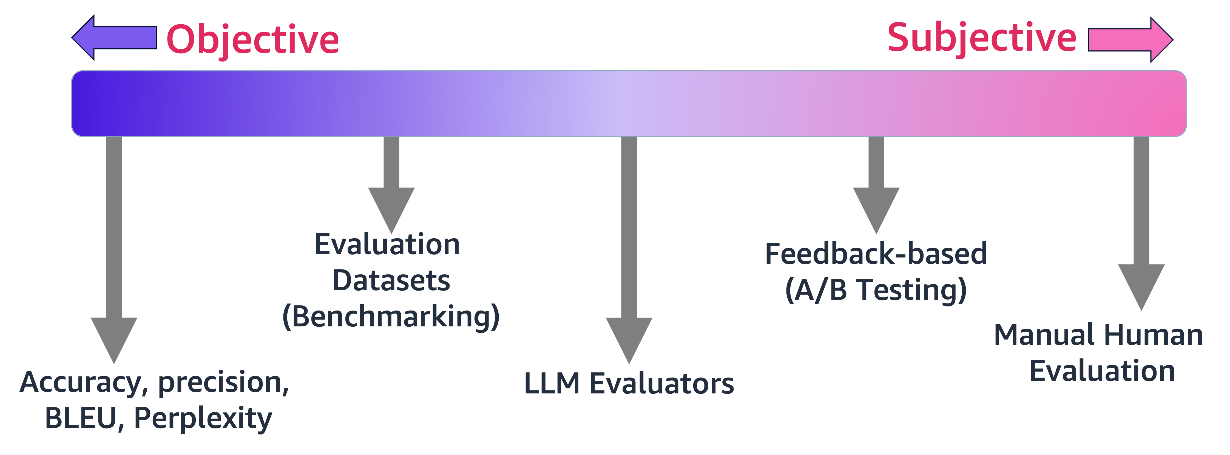
Spectrum of evaluation approaches
Notes:
Key points:
1. Evaluation Spectrum: Objective to Subjective
- The slide shows a gradient from objective (left/purple) to subjective (right/pink) evaluation methods
- Demonstrates the range of approaches available for assessing LLM performance
2. Objective Metrics:
- Accuracy: Measures correctness of model outputs
- Precision: Evaluates exactness of results
- BLEU: Scoring method for machine translation
- Perplexity: Measures how well model predicts sample
3. Evaluation Methods (Middle Ground):
- Evaluation Datasets (Benchmarking): Standardized datasets to compare models
- LLM Evaluators: Using other language models to evaluate outputs
4. Subjective Methods:
- Feedback-based (A/B Testing): Comparing different versions through user feedback
- Manual Human Evaluation: Direct assessment by human reviewers
EDUCATOR NOTES:
”Let’s look at the spectrum of LLM evaluation methods. On the left, we have our objective metrics - these are quantifiable measures like accuracy and BLEU scores that give us concrete numbers to work with. Moving towards the center, we use evaluation datasets and LLM evaluators as more structured assessment tools. On the right side, we have our subjective methods, including A/B testing and manual human evaluation, which provide valuable qualitative insights but are more resource-intensive and less scalable. The key is finding the right balance of these methods for your specific use case.
Remember that while objective metrics are easier to implement and compare, they don't always capture the nuanced aspects of language understanding and generation that subjective evaluations can reveal. A comprehensive evaluation strategy typically involves multiple methods across this spectrum."

Slide 16
Metric-based evaluation
Objective metrics to evaluate LLM performance
Do not extend easily to evaluate complex traits such as reasoning
A few examples:
Accuracy: Proportion of correct prediction
Perplexity: Likelihood of predicting the given text next
BLEU: Precision-based text comparison
ROUGE: Recall-oriented text evaluation
Notes:
Key points:
1. Metric-based Evaluation Overview:
- Forms part of the objective end of the evaluation spectrum
- Uses quantifiable measurements for LLM performance assessment
- Has inherent limitations with complex traits
2. Key Metrics Explained:
- Accuracy: Measures the ratio of correct predictions to total predictions
- Perplexity: Evaluates how well the model predicts the next text sequence
- BLEU (Bilingual Evaluation Understudy): Focuses on precision in text comparison
- ROUGE (Recall-Oriented Understudy for Gisting Evaluation): Emphasizes recall in text evaluation
EDUCATOR NOTES:
"In this discussion of LLM evaluation methods, we're focusing on metric-based evaluation, which represents the most objective end of our evaluation spectrum. While these metrics give us concrete numbers to work with - like accuracy percentages and BLEU scores - it's crucial to understand their limitations. For instance, while we can easily measure how often a model makes correct predictions, it's much harder to quantitatively assess its reasoning capabilities.
The metrics we've covered - Accuracy, Perplexity, BLEU, and ROUGE - each serve specific purposes. Accuracy gives us straightforward correctness measures, Perplexity helps us understand prediction capabilities, while BLEU and ROUGE offer different perspectives on text comparison and evaluation. However, remember that these metrics are just one part of a comprehensive evaluation strategy. For a complete assessment, we need to combine these objective metrics with more subjective methods like human evaluation and A/B testing.
The key takeaway is that while metric-based evaluation is essential for quantifiable comparisons, it shouldn't be your only evaluation tool. A balanced approach using multiple methods across the objective-subjective spectrum will give you the most comprehensive understanding of your LLM's performance."

Slide 17
Evaluation Datasets
Use of high quality benchmarking datasets
Test more complex traits leveraging objective metrics
Common sense reasoning
Arithmetic reasoning
General knowledge
Software development
Bias
Toxicity…
Notes:
Key points:
1. Evaluation Datasets Overview
- Primary focus on utilizing high-quality benchmarking datasets for testing
- Emphasis on comprehensive evaluation through complex traits assessment
2. Key Testing Areas
a) Core Reasoning Abilities
- Common sense reasoning capabilities
- Arithmetic reasoning skills
- General knowledge assessment
b) Technical Competencies
- Software development evaluation
- Implementation of objective metrics
c) Safety & Ethics Evaluation
- Bias detection and measurement
- Toxicity assessment
3. Methodology Highlights
- Leverages objective metrics for accurate measurement
- Uses standardized benchmarking approaches
- Focuses on comprehensive trait evaluation
EDUCATOR NOTES:
”Let’s explore how we utilize high-quality benchmarking datasets to evaluate various aspects of our systems. Our evaluation framework covers both fundamental capabilities like common sense and arithmetic reasoning, as well as complex traits such as software development skills. We pay special attention to critical areas like bias and toxicity to ensure responsible AI development. Through objective metrics, we can measure and validate performance across all these dimensions systematically. This comprehensive approach helps us maintain high standards and identify areas for improvement."

Slide 18
Examples of evaluation datasets
Massive Multitask Language Understanding (MMLU)
Measures general knowledge across 57 different subjects, ranging from STEM to social sciences
HellaSwag
Tests natural language inference in a way that requires understanding of intricate details
GSM8K
A set of 8.5K grade-school math problems that require basic to intermediate math operations
AGIEval
A collection of standardized tests, including GRE, GMAT, SAT, LSAT, and civil service exams
Responsible AI (RAI)
A framework for evaluating the safety of chat-optimized models in conversational settings
Notes:
Key points:
1. MMLU (Massive Multitask Language Understanding)
- Primary purpose: Evaluates general knowledge breadth
- Covers 57 distinct subject areas
- Range spans from STEM fields to social sciences
- Comprehensive assessment of knowledge across disciplines
2. HellaSwag
- Focus: Natural language inference testing
- Evaluates understanding of intricate details
- Tests ability to comprehend and process complex language patterns
3. GSM8K
- Type: Mathematical evaluation dataset
- Target level: Grade-school mathematics (8.5K problems)
- Tests: Basic to intermediate mathematical operations
- Assesses computational and problem-solving abilities
4. AGIEval
- Comprehensive standardized testing framework
- Includes multiple exam types:
* GRE
* GMAT
* SAT
* LSAT
* Civil service exams
- Broad spectrum of academic and professional assessment
5. RAI (Responsible AI)
- Purpose: Safety evaluation framework
- Specific focus: Chat-optimized models
- Application: Conversational settings
- Emphasis on responsible AI deployment
EDUCATOR NOTES:
”Let’s discuss now various evaluation datasets used in AI testing and assessment. These datasets represent different aspects of AI capability testing, from broad knowledge to specific skills. The MMLU gives us a comprehensive view of general knowledge, while HellaSwag tests natural language understanding at a deeper level. GSM8K focuses specifically on mathematical capability, and AGIEval provides a standardized testing approach. Finally, RAI addresses the crucial aspect of responsible AI deployment. Each dataset serves a unique purpose in ensuring robust AI system evaluation. Remember to emphasize the importance of using multiple evaluation methods for comprehensive assessment of AI systems."

Slide 19


HellaSwag: Example
Determining who has the right of way:
Come to a complete halt at a stop sign or red light. At a stop sign, come to a complete halt for about 2 seconds or until vehicles that arrived before you clear the intersection. If you are stopped at a red light, proceed when the light has turned green…
A: Stop for no more than 2 seconds, or until the light turns yellow. A red light in front of you indicates that you should stop
B: After you come to a complete stop, turn off your turn signal. Allow vehicles to move in different directions before moving onto the sidewalk
C: Stay out of oncoming traffic. People coming in from behind may elect to stay left or right
D: If the intersection has a white strip in your lane, stop before crossing this line. Wait until all traffic has cleared before crossing the intersection
Notes:
Key Points:
In this example, the model tries to inference the right answer. The correctness of the answers can be considered the labels to evaluate the model capacity for inferencing the right answers.
For this example, the correct answer is D
"If the intersection has a white strip in your lane, stop before crossing this line. Wait until all traffic has cleared before crossing the intersection"
Why other options are incorrect:
- Option A: Incorrect about yellow light timing
- Option B: Irrelevant information about turn signals and sidewalks
- Option C: Incomplete/incorrect guidance about traffic flow
EDUCATOR NOTES:
"This slide demonstrates the use of the HellaSwag dataset, which is a powerful tool for evaluating AI language models' common sense reasoning abilities. Let me break down why this example is particularly interesting:
1. Format Demonstration
- Notice how the question presents a scenario about traffic rules
- Followed by four possible continuations/completions
- Only one logically follows from the given context
2. HellaSwag Characteristics
- The incorrect answers (A, B, C) are plausible-sounding but contain subtle inconsistencies
- They're generated to be challenging distractors that test natural language understanding
- The correct answer (D) requires both traffic knowledge and logical reasoning
3. Model Evaluation Purpose
- This type of question tests whether AI models can:
* Understand real-world scenarios
* Apply common sense reasoning
* Identify subtle contextual inconsistencies
* Choose the most logical continuation
4. Teaching Point
- This example shows how HellaSwag creates challenging multiple-choice questions
- The wrong answers aren't obviously incorrect, making it a good test of true understanding
- It mimics real-world scenarios where subtle differences matter
Remember, HellaSwag is designed to be challenging even for advanced AI models, making it an excellent benchmark for testing natural language understanding and common sense reasoning capabilities."

Slide 20
Always evaluate, even if difficult
Never use an AI-generated solution without having evaluated it
Evaluating LLM outputs is hard
Focus on the metrics and benchmarks that are important for your use case
You will probably need to collect your own annotated benchmark dataset
In certain cases, automated metrics (accuracy, perplexity, …) might be enough to assess the LLM performance
It is likely you will need to engage human evaluators: you can use Amazon Bedrock’s Human-In-Loop (HIL) capabilities
Notes:
Key Notes:
1. Key Principle: Evaluation is Essential
- Critical warning: Never implement AI-generated solutions without proper evaluation
- This is a fundamental safety and quality control measure
2. LLM Output Evaluation Challenges
- Evaluating Large Language Model outputs presents significant difficulties
- Requires systematic and thorough approach
3. Evaluation Strategy Components
a) Metrics and Benchmarks
- Select metrics specific to your use case
- Focus on relevant benchmarks that align with objectives
b) Custom Benchmark Dataset
- Creating your own annotated benchmark dataset is often necessary
- Helps in testing specific use case scenarios
c) Automated Evaluation
- Metrics like accuracy and perplexity can be useful
- Automated evaluation may suffice in certain scenarios
d) Human Evaluation
- Human-In-Loop (HIL) evaluation through Amazon Bedrock
- Essential for complex assessments and validation
EDUCATOR NOTES:
"In this session, I want to emphasize the critical importance of evaluating AI-generated solutions. While AI tools are powerful, they require careful validation before implementation. The evaluation process can be challenging, especially with LLMs, but it's non-negotiable for ensuring quality and reliability.
I recommend a multi-faceted approach: start with clear metrics aligned to your specific use case, develop your own benchmark dataset if needed, and utilize automated metrics where appropriate. However, don't underestimate the value of human evaluation – Amazon Bedrock's HIL capabilities provide an excellent framework for this.
Remember, the goal isn't just to implement AI solutions, but to implement them responsibly and effectively. Taking the time to evaluate thoroughly will save you from potential issues down the line and ensure better outcomes for your projects."

Slide 21
Performance Evaluation on Amazon Bedrock

Slide 22
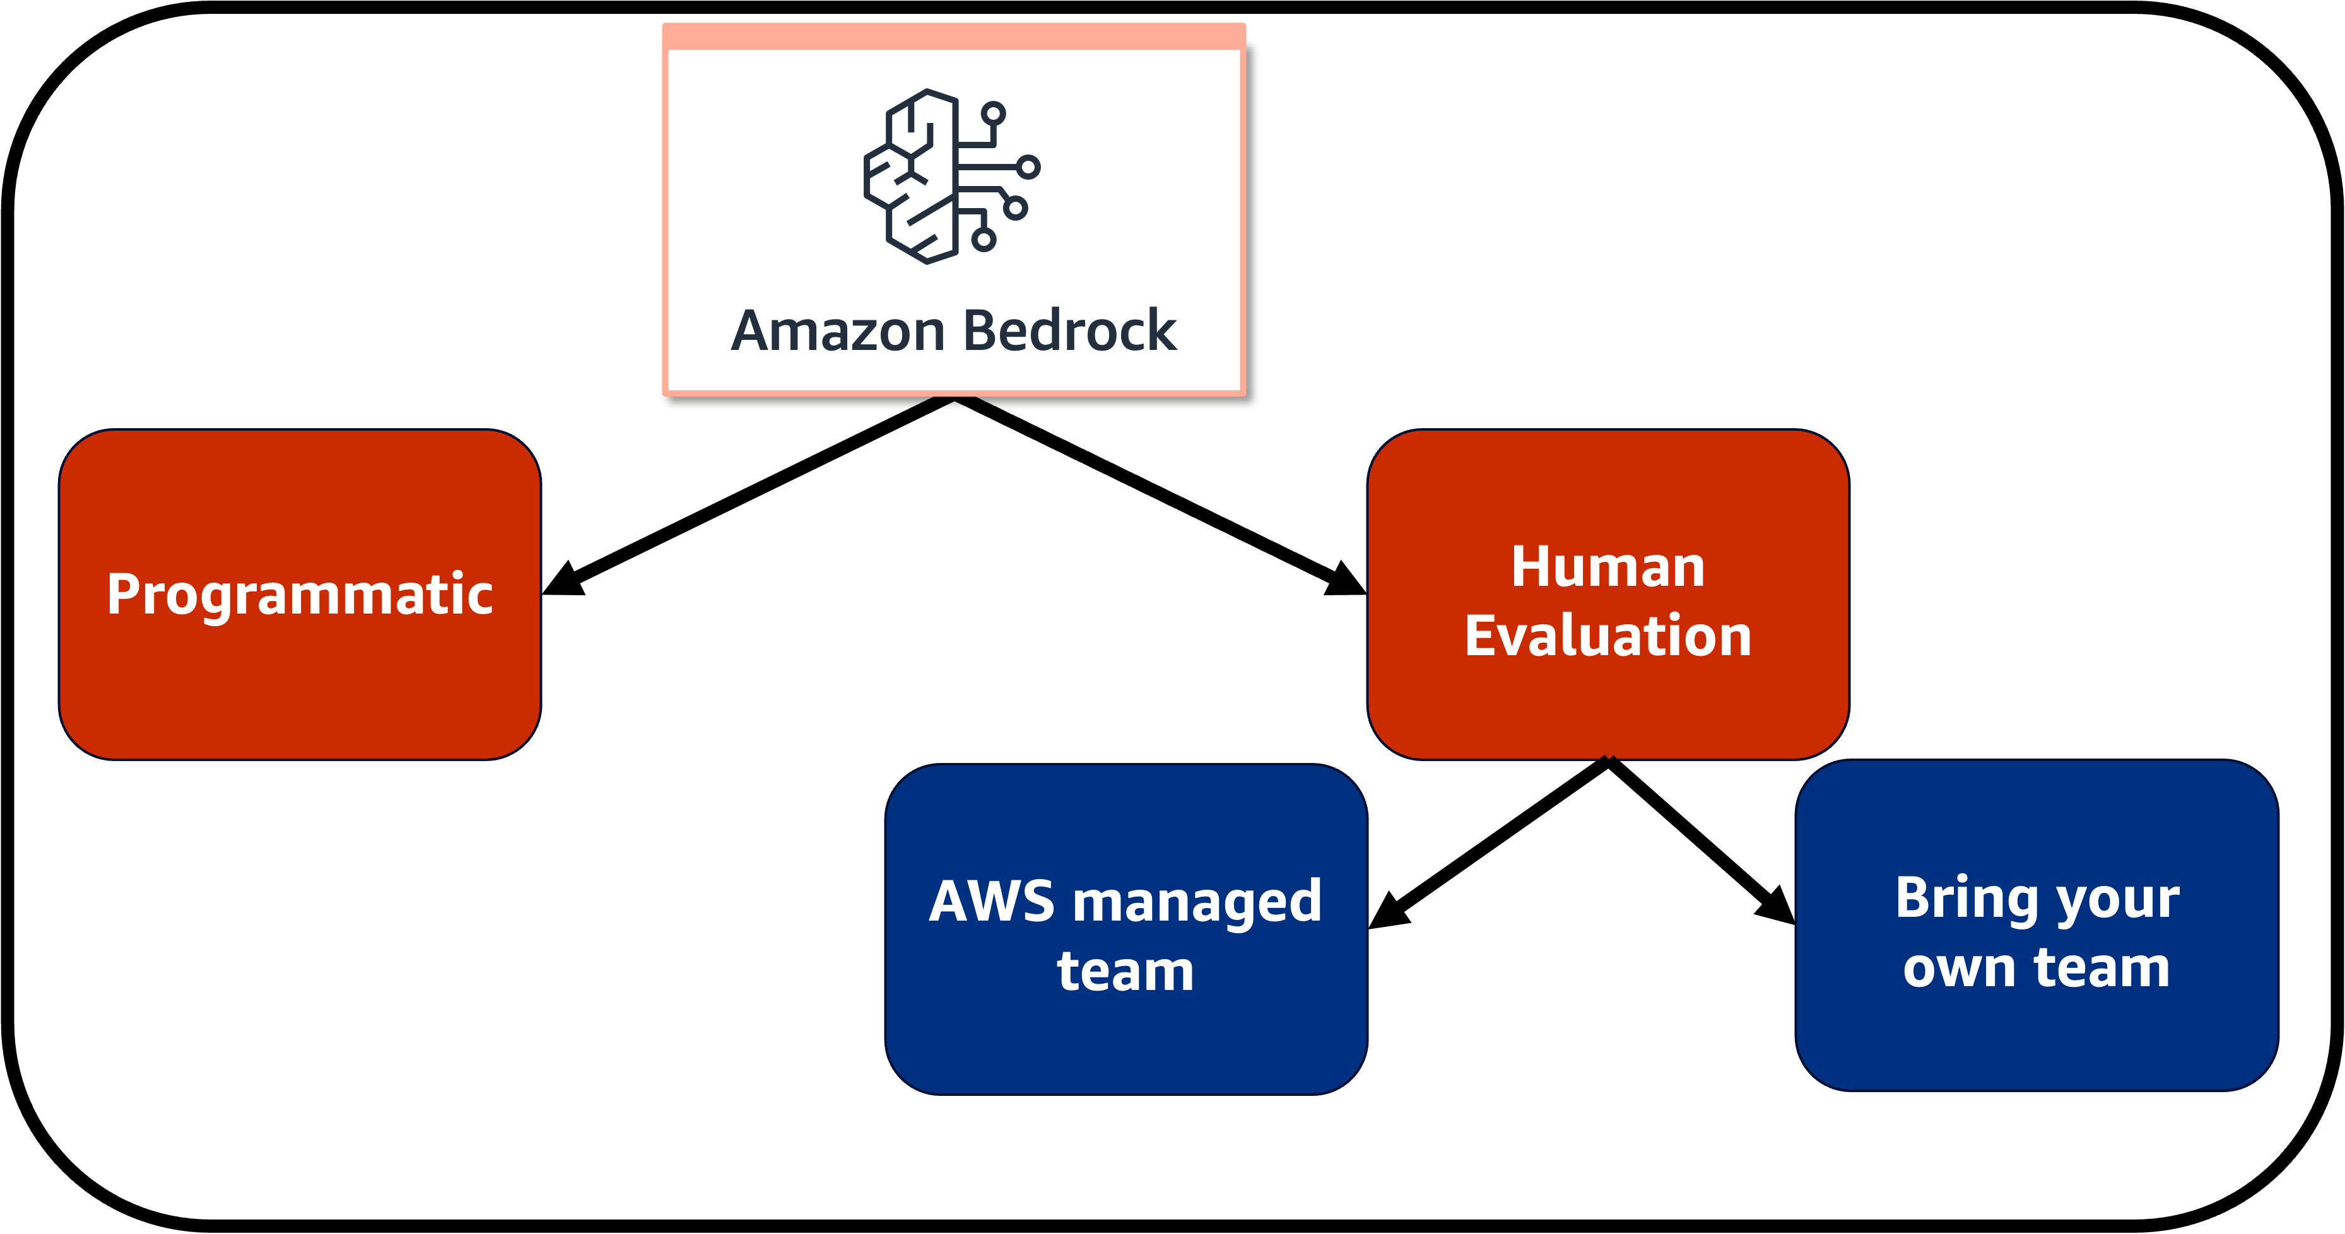
Evaluation on Amazon Bedrock
Notes:
Key Notes:
2. Core Components:
- Amazon Bedrock (central element)
- Two main evaluation approaches:
* Programmatic Evaluation
* Human Evaluation
3. Team Implementation Options:
For each evaluation type, there are two team structures:
- AWS Managed Team
- Bring Your Own Team (BYOT)
4. Structure:
- Hierarchical organization showing evaluation methods branching into team options
- Clear distinction between evaluation types (shown in red) and team options (shown in blue)
EDUCATOR NOTES:
”Let’s discuss the evaluation framework for Amazon Bedrock. We have two primary approaches to evaluation: programmatic and human evaluation. Each of these can be implemented either with an AWS managed team or your own team, giving you flexibility in how you approach quality assurance.
For programmatic evaluation, you can either leverage AWS's expertise through our managed team or implement it with your internal resources. Similarly, for human evaluation, you can choose between AWS-provided evaluators or your own team members.
This flexible structure ensures that regardless of your organization's resources and preferences, you can implement robust evaluation processes for your Bedrock applications. The choice between AWS managed and bring-your-own teams allows you to balance factors like control, expertise, and resource availability according to your specific needs."
END OF NOTES

Slide 23

Programmatic evaluation
1
2
3
4
Choose a FM
Select task type
Choose metric
Select dataset
or upload a dataset
Amazon Bedrock
Select a foundation model from Amazon Bedrock
Select the type of task for evaluation
Text generation, classification, Q&A, etc.
Choose the set of metrics
Accuracy, Robustness, Toxicity, etc.
Select an available dataset or upload your own prompt dataset
Notes:
Key points:
Main Focus: Amazon Bedrock Foundation Model Evaluation Process
Key Steps:
1. Foundation Model Selection
- Choose from available Amazon Bedrock foundation models
- Consider model capabilities and use case requirements
2. Task Type Selection
- Options include:
* Text generation
* Classification
* Question & Answer (Q&A)
* Other task types based on requirements
3. Metrics Selection
- Key evaluation metrics include:
* Accuracy
* Robustness
* Toxicity
* Other relevant performance metrics
4. Dataset Selection
- Two options available:
* Select from pre-existing datasets
* Upload custom prompt dataset
EDUCATOR NOTES:
”Let’s walk through the programmatic evaluation process for Amazon Bedrock foundation models. This four-step approach ensures systematic and thorough model assessment.
Start by selecting an appropriate foundation model from Amazon Bedrock that aligns with your use case. Then, specify the type of task you want to evaluate - whether it's text generation, classification, or Q&A capabilities.
The third step is crucial - choosing the right metrics. We'll measure aspects like accuracy, robustness, and toxicity to ensure the model meets your quality standards. Finally, you can either use our available datasets or bring your own prompt dataset for testing.
Remember, this evaluation process is designed to help you make informed decisions about which model best suits your specific needs and requirements. Let's dive deeper into each step...”
1. Choose a Foundation Model (FM) from Amazon Bedrock:
- This is the first crucial step where you select an appropriate foundation model from Amazon Bedrock's offerings
- Different models have different strengths and specializations
- Selection should be based on:
* Your specific use case requirements
* Model capabilities
* Language support needs
* Performance requirements
* Cost considerations
2. Select Task Type for Evaluation:
- Choose the specific task you want to evaluate the model on:
* Text Generation: Creating coherent and contextually relevant text
* Classification: Categorizing input into predefined classes
* Q&A: Answering questions based on given context
* Other specialized tasks like summarization, translation, etc.
- The task type should align with your intended production use case
3. Choose Set of Metrics:
- Select appropriate evaluation metrics to measure model performance:
* Accuracy: How correct are the model's outputs
* Robustness: How well the model handles varying inputs
* Toxicity: Measuring inappropriate or harmful content
* Other possible metrics:
- Response time
- Token efficiency
- Consistency
- Relevance
- Hallucination rate
4. Dataset Selection:
- Two options available:
* Use pre-existing datasets:
- Validated datasets suitable for your task
- Industry-standard benchmarks
* Upload custom prompt dataset:
- Your own specific use case data
- Real-world examples from your domain
- Custom test cases
- The dataset should be representative of the actual data the model will encounter in production
Each step builds upon the previous one to create a comprehensive evaluation framework that helps in:
- Making informed decisions about model selection
- Understanding model performance characteristics
- Identifying potential issues before deployment
- Ensuring the model meets your specific requirements
- Creating reproducible evaluation processes
This systematic approach ensures that the selected model is thoroughly tested and validated before being implemented in a production environment.

Slide 24
Manual evaluation
Human evaluations supported by Amazon Bedrock
Evaluate responses from up to two models
Two options for evaluation:
Bring your own team
AWS Managed work team
Notes:
Key points:
1. Manual Evaluation Overview
- Amazon Bedrock provides support for human-based evaluations
- Capability to evaluate and compare responses from maximum two models
- Focuses on qualitative assessment by human evaluators
2. Evaluation Team Options
a) Bring Your Own Team (BYOT)
- Organizations can use their internal evaluators
- Allows for domain expertise and familiar context
- Provides control over evaluation process
b) AWS Managed Work Team
- Pre-vetted evaluators provided by AWS
- Professional evaluation service
- Standardized evaluation approach
EDUCATOR NOTES:
"In this slide, we're discussing the manual evaluation capabilities supported by Amazon Bedrock. This is a crucial feature that allows organizations to conduct human-based assessments of model responses. You can compare up to two different models side by side, which is particularly useful for model selection and quality assurance.
Bedrock offers two flexible options for conducting these evaluations. You can either bring your own team of evaluators, which is ideal if you have specific domain expertise requirements or want to maintain internal control. Alternatively, you can leverage our AWS Managed work team, which provides access to professional evaluators who are already familiar with the evaluation process.
Remember, human evaluation is essential for ensuring model outputs align with your business requirements and quality standards."

Slide 25
How human evaluation works (Bring your own team)
Choose 1 or 2 models
Choose task type
Use recommended metrics or define your own
Upload dataset
Add people to work team
Inference
Human evaluation
View results
Notes:
Key notes:
1. Process Overview
The image shows an 8-step workflow for conducting human evaluation, designed for teams to implement and execute evaluations effectively.
2. Key Steps (in order):
- Choose 1 or 2 models to evaluate
- Choose task type
- Use recommended metrics or define custom ones
- Upload dataset
- Add people to work team
- Run inference
- Conduct human evaluation
- View results
3. Important Considerations:
- The process emphasizes bringing your own team ("Bring your own team" subtitle)
- Follows a logical progression from model selection to results analysis
- Incorporates both automated (inference) and human elements
- Structured approach to evaluation
EDUCATOR NOTES:
"Let’s walk through the human evaluation workflow, which is essential for assessing model performance. This is a comprehensive 8-step process that combines both technical and human elements.
Key points to emphasize:
- Start by carefully selecting your models - you can evaluate one or two at a time
- The choice of task type will influence your evaluation metrics
- You have flexibility in metric selection - use recommended ones or create custom metrics
- Team selection is crucial - ensure your evaluators understand the objectives
- The process combines automated inference with human judgment
- Results viewing is the final step, but insights gained should inform future iterations
Remember, the quality of your evaluation depends heavily on both the process design and the team executing it. Take time to set up each step properly.
This structured approach ensures consistent and reliable human evaluation of model performance while maintaining flexibility for different use cases and requirements.

Slide 26
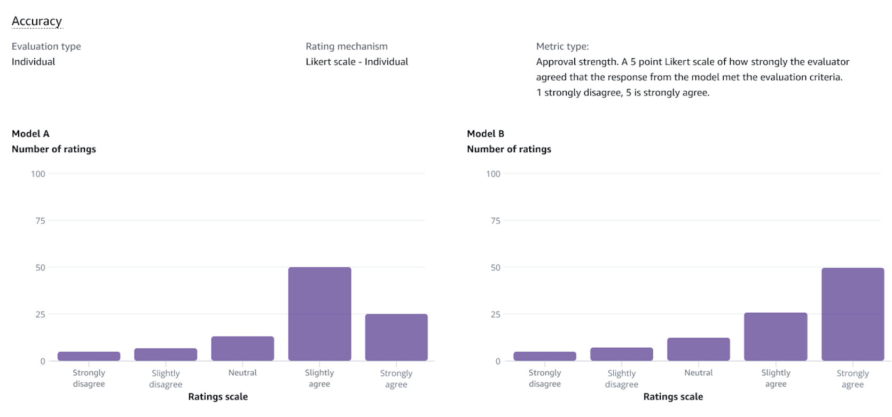

Analyze results
Evaluation report:
Track ratings from your team
See distributions visually
Simple metric explanations
Notes:
Key notes:
"Analyze Results" Slide
- Main title slide introducing the evaluation report section
- Highlights three key features:
1. Track ratings from team
2. Visual distribution analysis
3. Simple metric explanations
Evaluation Report Details:
- Evaluation Type: Individual
- Rating Mechanism: Likert scale (Individual)
- Metric Type: Approval strength using 5-point Likert scale
* Scale ranges from 1 (strongly disagree) to 5 (strongly agree)
- Shows comparison between Model A and Model B responses
- Both graphs display distribution of ratings across the scale
Graph Analysis:
Model A:
- Shows skew towards positive ratings
- Highest concentration in "Slightly agree"
- Lower numbers in "Strongly disagree" and "Slightly disagree"
- Moderate neutral responses
Model B:
- Stronger positive skew
- Highest concentration in "Strongly agree"
- Lower representation in negative ratings
- Consistent pattern of increasing agreement
EDUCATOR NOTES:
”Let’s analyze our evaluation results comparing Models A and B. The data represents individual ratings using a 5-point Likert scale measuring approval strength.
Looking at the distributions, we can observe that both models received generally positive feedback, but with some notable differences:
Model A shows a moderate positive skew with most responses clustering around 'Slightly agree.' This suggests general approval but with some room for improvement.
Model B demonstrates stronger performance with a clear shift toward 'Strongly agree' responses, indicating higher overall approval rates.
The key takeaway is that while both models are performing adequately, Model B appears to be generating more consistently favorable responses from our evaluation team.”

Slide 27

Next lesson
This lesson covered topics related to evaluation of LLMs
In the next lesson, you will learn about foundations of responsible AI.

Slide 28
Notes:
Thank you for your participation in this course! We appreciate your engagement and hope you found the content valuable.

Slide 29
Spectrum of evaluation approaches
Objective
Subjective
Evaluation
Datasets (Benchmarking)
Feedback-based (A/B Testing)
Manual Human
Evaluation
Accuracy, precision, BLEU, Perplexity
LLM Evaluators
Notes:
This is the original slide before its components were combined into a single image, for accessibility purposes, in this slide deck. Use this slide to update content and then recreate the image for the associated slide in the lesson.

Slide 30
Evaluation on Amazon Bedrock
Amazon Bedrock
Programmatic
Human Evaluation
AWS managed team
Bring your own team
Notes:
This is the original slide before its components were combined into a single image, for accessibility purposes, in this slide deck. Use this slide to update content and then recreate the image for the associated slide in the lesson.

